Slide 1
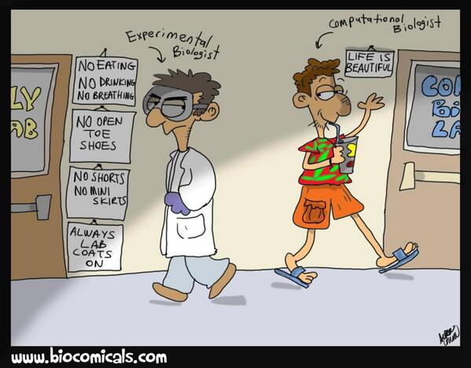

Core Bioinformatics Skills
Lachlan McKinnie, Alumni,
University of the Sunshine Coast
Lachlan.McKinnie@research.usc.edu.au

Slide 2

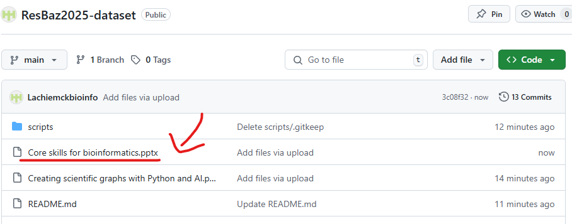
Slides
Introduction
Starting Out
Slides available via GitHub
https://github.com/Lachiemckbioinfo/ResBaz2025-dataset
Click on file, click dots on top-right, and select download
Project considerations
Coding
Documentation
AI
Further Info

Slide 3
Who am I?
Introduction
Starting Out
Project considerations
I am Lachlan McKinnie, a recent PhD graduate in bioinformatics
Background in genomics and molecular biology
PhD focus on red algae, secondary metabolism, transcription factors
Data collation, annotation, data mining, database and web design
VERY early career researcher
Just a tiny bit silly
Coding
Documentation
Personal lessons
Further Info

Slide 4
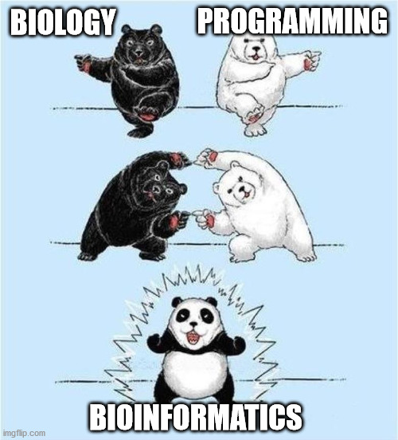
What is in this session?
Introduction
Starting Out
This presentation will go over some of my experiences in bioinformatics, and core lessons I learned from them.
I will go over core bioinformatics concepts, important knowledge, and tools.
While this session looks at bioinformatics, most of it is applicable to other fields using data science(e.g., physics, chemistry, social sciences)
Project considerations
Coding
Documentation
AI
Further Info

Slide 5
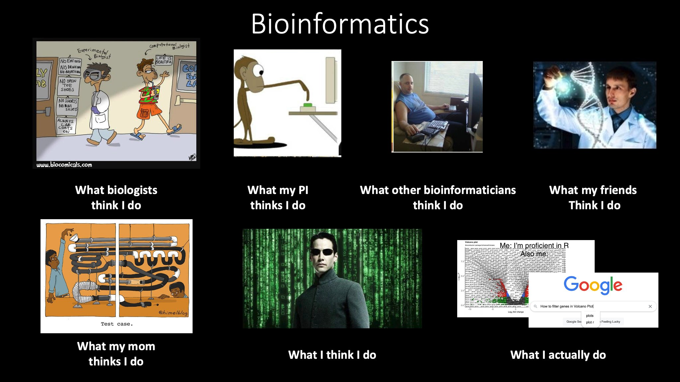

Slide 6
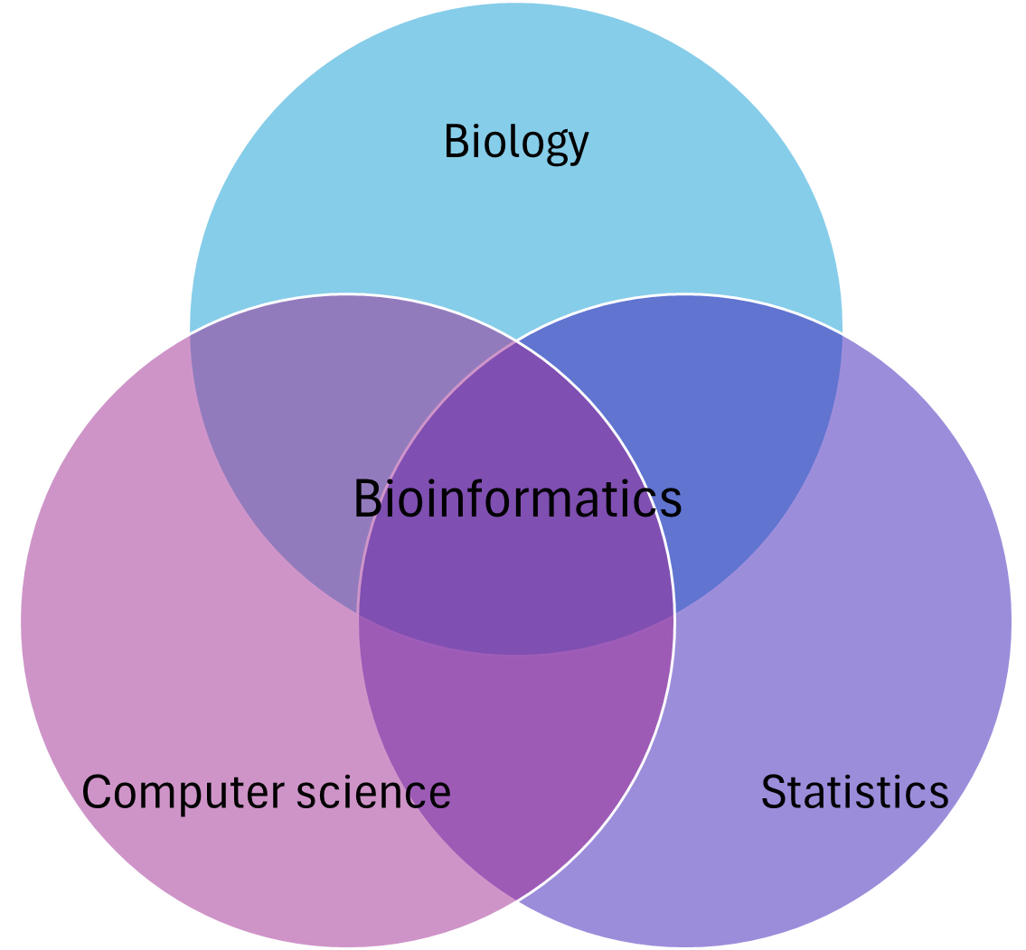
Introduction – what is bioinformatics
Introduction
Starting Out
Project considerations
Intersection of biology, computer science, and statistics.
Both the usage of informatics tools to analyse biology, and the development of said tools
Overlap with computational biology
Coding
Documentation
AI
Further Info

Slide 7
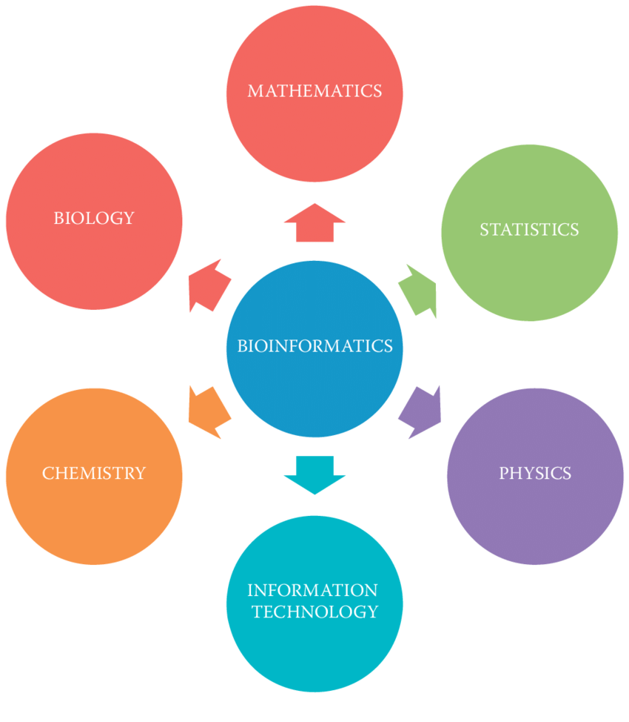
Applications of bioinformatics
Introduction
Starting Out
Project considerations
Bioinformatics intersects with many other fields
Chemistry, physics, IT, mathematics
Drug development, conservation, personalised medicine, agriculture, public health
Coding
Documentation
AI
Further Info
[1]: Sharma, D., Singh, S., & Mittal, M. (2021). Bioinformatics and RNA: A Practice-Based Approach (1st ed.). CRC Press. https://doi.org/10.1201/9781003107736

Slide 8

What are you interested in?
Introduction
Starting Out
Project considerations
menti.com
Code: 7899 3549
Coding
Documentation
AI
Further Info
Notes:
https://www.mentimeter.com/app/presentation/al73q4ie44p55eqsxxvknheq4qko8z5i/edit?question=ityhzq73emhs

Slide 9
Starting Out
Introduction
Starting Out
Project considerations
Background was in genetics, molecular biology, and some microbiology
Had used bioinformatics workbenches (CLC, Geneious) and done tasks like BLAST, protein modelling
Basic Python and R skills
Never touched Linux before
Adamant I would not be a programmer – could only write basic code, not make anything complex.
Coding
Documentation
AI
Further Info

Slide 10
Starting Out
Introduction
Starting Out
Project considerations
You don’t need a computer science degree to do bioinformatics.
Conversely, you don’t need to be a biologist to learn bioinformatics.
You don’t need to know how to code to start bioinformatics – but key for professional bioinformaticians.
Coding
Documentation
AI
Further Info

Slide 11

Starting Out
Introduction
Starting Out
Ask yourself – are you using bioinformatics, or do you want to be a bioinformatician?
Will you be using tools or designing them?
Are you focusing more on the biology or the information technology?
Project considerations
Coding
Documentation
AI
Further Info
There is no correct answer. All are valid options.

Slide 12
Project considerations
Introduction
Starting Out
Project considerations
Collaborative experiment design
Manage scope
Ensure good data management
Ensure data traceability
Determine metadata and metadata reporting
Coordinate data and internet security
Control data quality
Identify suitable tools
Track, record, and confirm workflow changes
Repurpose the data
Coding
Documentation
AI
Further Info
[2]: Kumuthini, J., et al, 2020. Ten simple rules for providing effective bioinformatics research support. PLoS computational biology, 16(3), p.e1007531.
Notes:
This paper is mostly under the lens of providing bioinformatics support to a larger project, but it applicable to bioinformatics-only projects as well.

Slide 13
Skills and tools
Introduction
Starting Out
Project considerations
Look at what tools and skills are needed for the project
Investigate alternative tools
Keep training new skills – will come in handy in future
Coding
Documentation
AI
Further Info

Slide 14
Important skills and tools to learn
Introduction
Starting Out
Project considerations
Version control/reproducibility
Git, GitHub, Conda, Docker
Coding
Workflows and pipelines
NextFlow, SnakeMake, custom scripting
Documentation
AI
Statistics and visualisation
MatLab, R/Python, various online resources
Further Info
Data transfer and access
Tools like FileSender (AARNet), Globus. Command like tools like SSH, SCP, FTP
Coding and scripting
Numerous languages to choose from

Slide 15
Making Your Research Accessible
Introduction
Starting Out
Project considerations
As with other research, bioinformatics research needs to be accessible and communicable
We can use the FAIR framework to ensure people can access and use our data
Coding
Documentation
AI
Further Info

Slide 16
FAIR Principles
Introduction
Starting Out
Project considerations
Findable
Data and metadata should be easy for both computers and humans to find. Use descriptive metadata (keywords, access rights) and persistent identifiers (like DOI).
Coding Fundamentals
Documentation
Accessible
Data and metadata should be retrievable. There should be authorisation procedures where necessary.
AI
Further Info
Interoperable
The data should be able to be integrated with other data and be interoperable with other workflows.
Reusable
The data should be well-described so that it can be replicated and reused. It should have a clear and accessible data usage license and meet relevant standards.

Slide 17
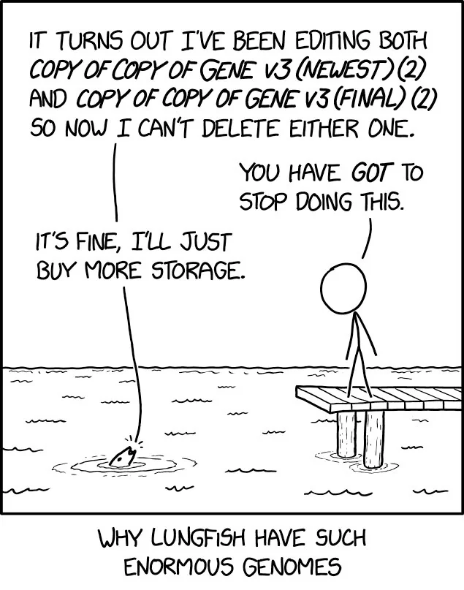
File Management
Introduction
Starting Out
Project considerations
Efficient file management is key
You may have to transform files multiple times – .fastq to .fasta to .fas/.faa/.fna
Record changes to files and directories
Coding Fundamentals
Documentation
AI
Further Info

Slide 18
File Management
Introduction
Starting Out
Project considerations
Example: I had to redo some analyses from my thesis for a paper
Problem – I couldn’t find the save files. Had to redo them from scratch
Coding
Documentation
AI
Further Info

Slide 19
Documentation
Introduction
Starting Out
Project considerations
Bioinformatics projects contain lots of documentation – both to read and write
Can be methods, research logs, faqs, manuals, etc
Read the documentation – access many helpful features
Documentation can be daunting, but is truly helpful once you break it down
Coding
Documentation
AI
Further Info

Slide 20
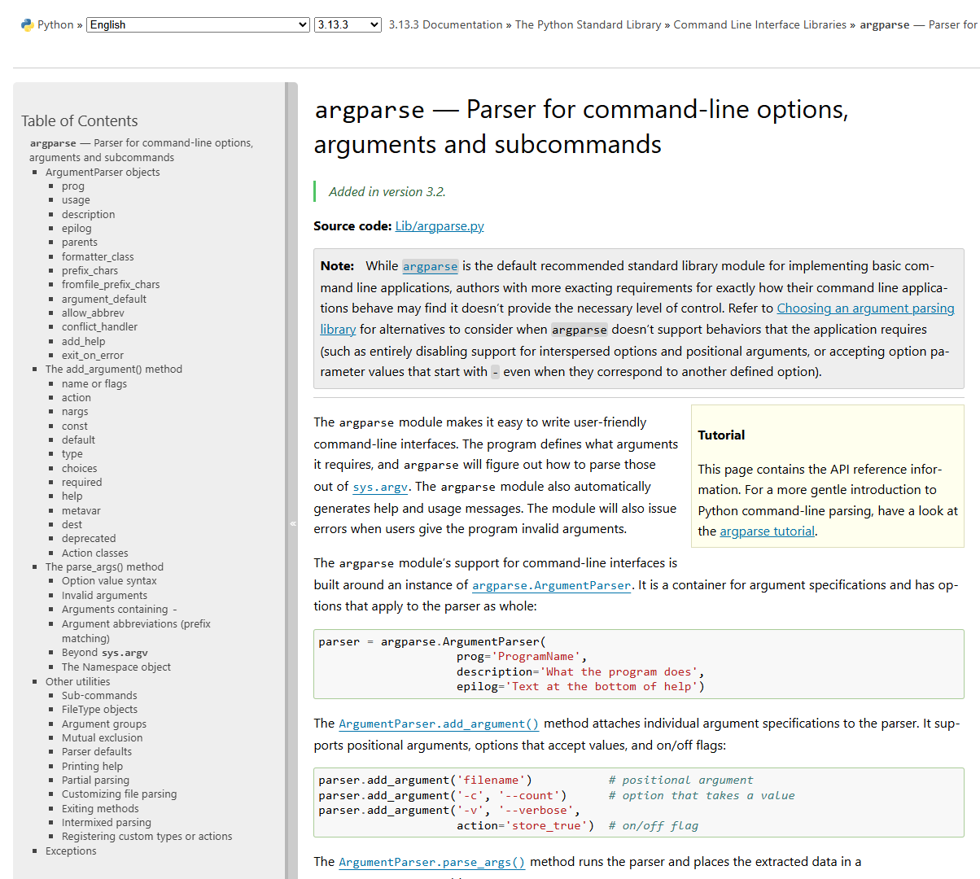
Reading Documentation
Introduction
Starting Out
Project considerations
Difficult to read at first
Break down specific parts
Look for what you can understand first, work from there
Coding
Documentation
AI
Further Info

Slide 21
Writing Documentation
Introduction
Starting Out
Project considerations
When you make something, document it
When you come back in 6 months, will you remember how your tool works?
Comment your code, both for yourself and others.
Automated documentation tools are available for various codebases
Coding
Documentation
AI
Further Info

Slide 22
Writing Documentation
Introduction
Starting Out
Format | Content | Audience
Manuscript | Conceptual and technical details of the method | New users
Readme | Basic instructions for installation and use of the software and where to find more information | New users
Quick start | Step-by-step instructions for installation and use of the software on a provided test data set | New users
Reference manual | Complete details of every configurable setting, input and output | All users
FAQ | Answers to commonly asked or anticipated questions | All users
Searchable forum or mailing list | News and discussion of details not otherwise provided in the documentation or not apparent to users | All users
Built-in help | Concise description of a software component and its parameters | Experienced users
News | Changes in behavior, bug fixes, new features and caveats | Experienced users
Code comments | Extensive details of implementation | Power users
Project considerations
Coding
Documentation
AI
Further Info
[3]: Karimzadeh, M. and Hoffman, M.M., 2018. Top considerations for creating bioinformatics software documentation. Briefings in Bioinformatics, 19(4), pp.693-699.

Slide 23
Coding – Do I Need to Code?
Introduction
Starting Out
Project considerations
Do you need to code to use bioinformatics? NO!*
Many non-coding alternatives for bioinformatics (and other data science tasks)
Bioinformatics workbenches (CLC, OmicsBox)
Website-based programs (Galaxy)
GUI-based programs(MEGA)
*However, advanced bioinformatics positions typically require coding
Coding will open up many possibilities in bioinformatics
Coding
Documentation
AI
Further Info

Slide 24
Coding – Do I Need to Code?
Introduction
Starting Out
Project considerations
Do you need to code to use bioinformatics? NO!*
Many non-coding alternatives for bioinformatics (and other data science tasks)
Bioinformatics workbenches (CLC, OmicsBox)
Website-based programs (Galaxy)
GUI-based programs(MEGA)
*However, advanced bioinformatics positions typically require coding
Coding will open up many possibilities in bioinformatics
Coding
Documentation
AI
Further Info

Slide 25
To code or not to code
Introduction
Introduction
Starting Out
Project considerations
Benefits of coding
Difficulties with coding
Coding
Automation of processes
Programmatic workflows
Precise control of tasks
Transferable skill
Many specialised tools are command line
Skill requirements
Installation and environment management
Documentation
AI
Further Info

Slide 26
Bioinformatics Workbenches
Introduction
Starting Out
Project considerations
Program packages containing numerous bioinformatics functions. Extremely powerful and convenient.
Commercial programs, and licenses can be quite expensive.
Notable examples include CLC Genomics Workbench, Geneious, OmicsBox
Coding
Documentation
AI
Further Info

Slide 27
Coding languages
Introduction
Starting Out
Project considerations
There are dozens of coding languages and various types
Python, R, Perl, Java, JavaScript, C, C++, C#, SQL, Bash, Rust
Major paradigms (types): Object Oriented Programming (OOP), Procedural, Fundamental, Scripting, Logic programming languages
Coding
Documentation
AI
Further Info

Slide 28

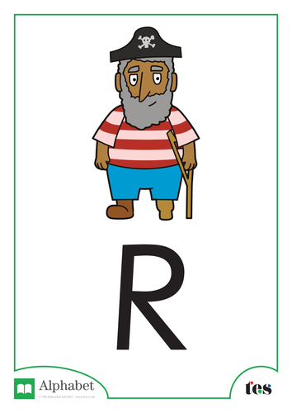


Coding – which language to use?
Introduction
Starting Out
PROS
CONS
Project considerations
Python
Easy for beginners
Widely used, broad applications
Lots of documentation
Memory intensive, energy inefficient
Slower than other languages
Coding
Documentation
R
Similar to Python, easy to learn
Designed for data science
Lots of support
Not as suited for software development
AI
C/C++
High performance
Excellent error handling
Highly portable
High complexity
Hard to debug
Tricky syntax
Further Info
Java
Used in many older applications
Platform independence
Scalable
Licensing issues
GUI issues due to
Perl
Strong regex
Platform independence
Incredibly flexible
Declining use
SQL
Database language
Multiple available versions
Fast, secure, and scalable
Complexity
Cost (for some versions)
Less flexibility

Slide 29


R vs Python
Introduction
Starting Out
Project considerations
There is no “must know” language
Preferences differ by group
Great stats, data science support for R
Greater non-stats versatility for Python
Coding
Documentation
AI
Further Info

Slide 30
Useful skills for coding and development
Introduction
Starting Out
Project considerations
Pseudocode
Rubber ducking
Coding
Documentation
AI
Further Info

Slide 31
Pseudocode
Introduction
Starting Out
Project considerations
Pseudocode is a way of preparing code
Simplified or plaintext way to go through how code works
I would write down code on a whiteboard when struggling with concepts
Coding
Documentation
AI
Further Info

Slide 32
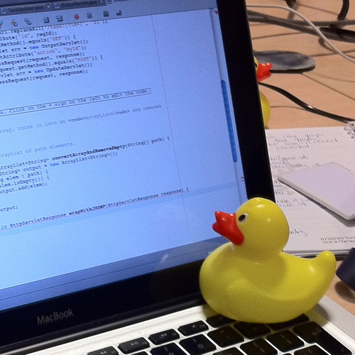
Rubber Ducking
Introduction
Starting Out
Project considerations
Have you ever asked a question, and just by asking it, figured out the answer?
Talking through concepts can help us understand them.
Teaching is a great way to learn.
I for one welcome our new rubber ducky overlords.
Coding
Documentation
AI
Further Info

Slide 33

Linux and Bash systems
Introduction
Starting Out
Project considerations
Many advanced bioinformatics packages run on Linux
Linux is a family of UNIX based operating systems
Powerful, open-source command line tools
FREE
Coding
AI
Lessons learned
Further Info

Slide 34
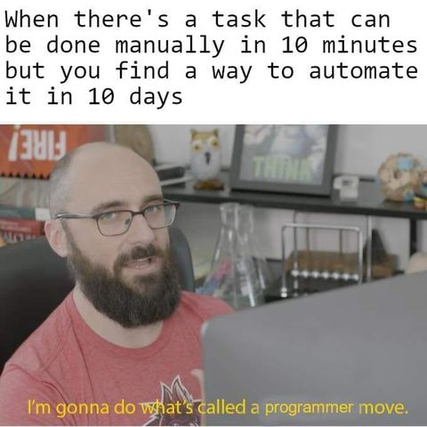
Thinking at scale
Introduction
Starting Out
Project considerations
Bioinformatics has strength in scale – tasks can be automated
Do your tasks need to be done more than once?
Two personal examples – simplifying data analysis, and automating data access
Coding
Lessons learned
AI
Further Info

Slide 35
Thinking at scale – simplifying data analysis
Introduction
Starting Out
Project considerations
I had metabolic data that needed analysis via the KEGG database
I started by analysing data manually – terrible idea
Semi-automated it using Excel – recorded all the data, used formulas
Coding
Lessons learned
AI
Further Info

Slide 36
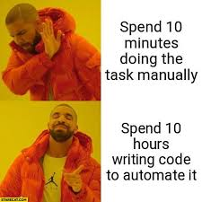
Thinking at scale – automating data access
Introduction
Starting Out
Project considerations
For another example, collaboration required metabolic data from genome data
Used Python code to automate the process
Built a program from the initial scripts
Turned into a side project
Coding
Lessons learned
AI
Further Info

Slide 37
Identify the Gap - Do I Need to Make This?
Introduction
Starting Out
Project considerations
An important question to ask is “do I need to make/do this”?
What would make it stand out?
Identify the gap. What isn’t covered by pre-existing resources?
For example, my website already had competition, both larger and more specialised, but not in my niche, and they had limits in their UI design.
Coding
Lessons learned
AI
Further Info

Slide 38
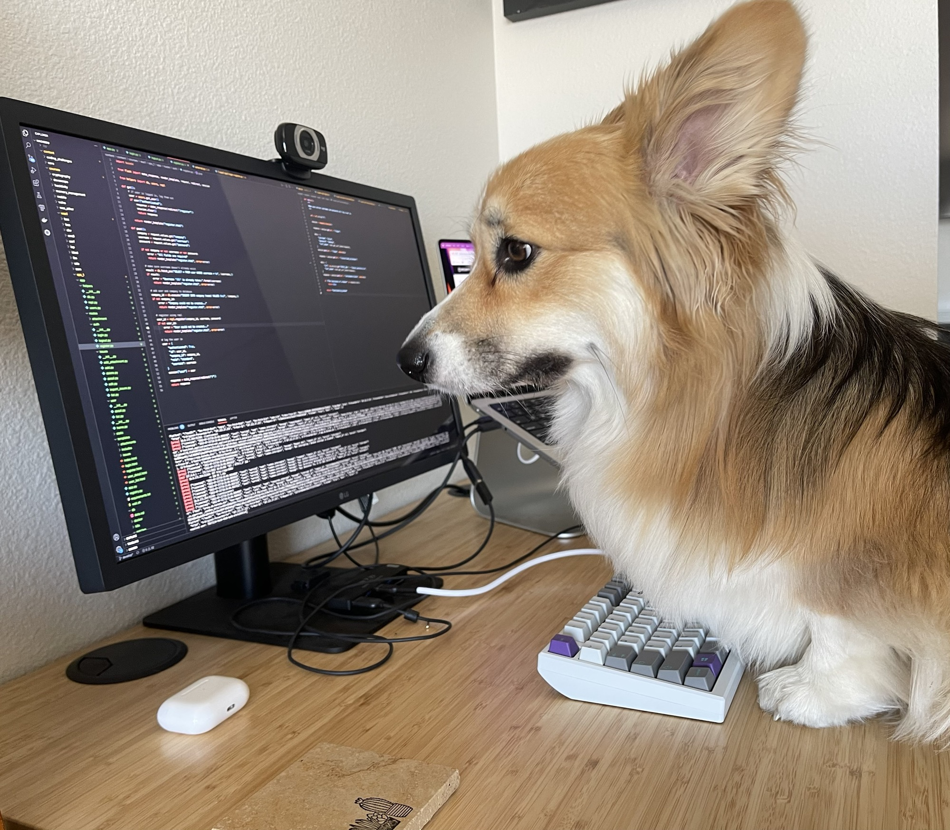
Making a website, and lessons I learned
Introduction
Starting Out
Project considerations
Do I need to make a website?
How do I make a website?
What frameworks or tools should I use?
Coding
Lessons learned
AI
Further Info
https://www.reddit.com/r/corgi/comments/148pj7t/doing_a_code_review/

Slide 39
AI: To Use or Not to Use
Introduction
Starting Out
Project considerations
Pros
Cons
Coding
Can immensely speed up work
Can produce code that you are not familiar with
Good sounding board for ideas
Can inhibit learning if you rely on AI
Data may be kept for training their engine – NOT SECURE
Not accurate when relying on factual accuracy
Can be a Yes-man – can agree with you even if you are wrong
Lessons learned
AI
Further Info

Slide 40
Summary
Introduction
Starting Out
Project considerations
Is bioinformatics your core skill set, or a supplemental skill set?
Planning and research design is key
Keep detailed and helpful documentation
Investigate the tools you need to use
Identify the gap – does the tool need making?
Think at scale – do you need to do this more than twice?
Focus on the data – how will it be used?
AI can be powerful but has downsides. Use it responsibly.
Coding
Lessons learned
AI
Further Info

Slide 41
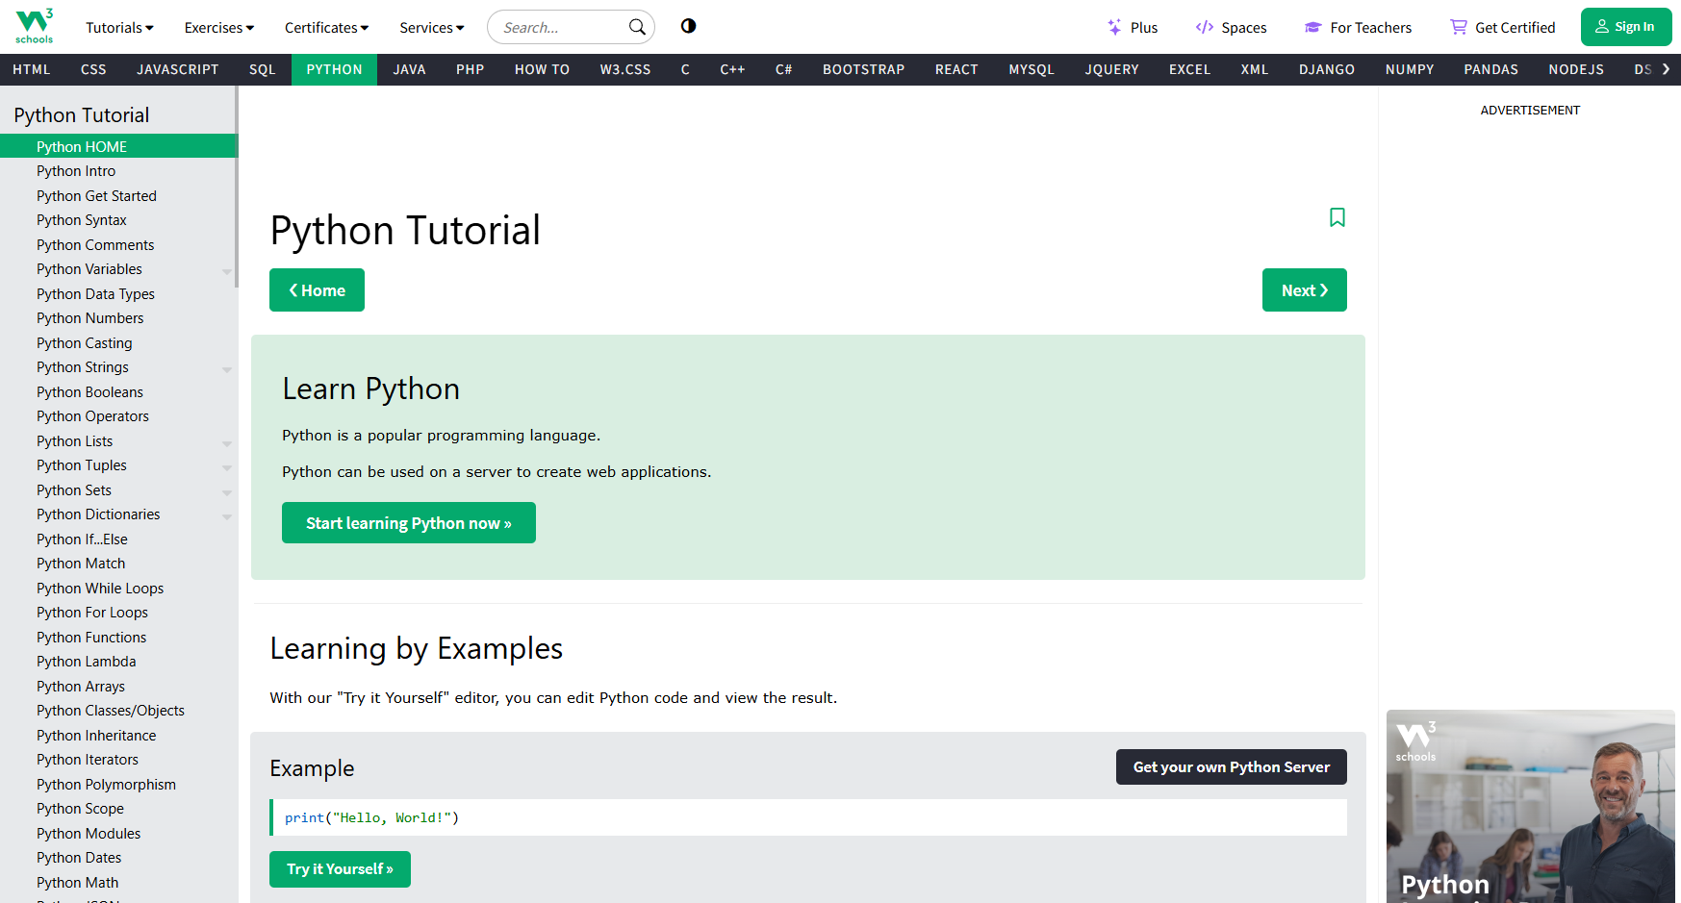
Learning Resources - Web3Schools
Introduction
Starting Out
https://www.w3schools.com/
Project considerations
Coding
Lessons learned
AI
Further Info

Slide 42
Learning Resources
Introduction
Starting Out
Project considerations
Web3Schools: https://www.w3schools.com/
Data Carpentry: https://datacarpentry.org/lessons/
StackOverFlow: https://stackoverflow.com/questions
Khan Academy: https://www.khanacademy.org/
Coding
Lessons learned
AI
Further Info

Slide 43
Tools
Introduction
Starting Out
Project considerations
Galaxy Australia: https://usegalaxy.org.au/
Nextflow: https://www.nextflow.io/
Anaconda: https://anaconda.org/
Coding
Lessons learned
AI
Further Info

Slide 44
Information
Introduction
Starting Out
Project considerations
FAIR Principles: https://www.go-fair.org/fair-principles/
QCIF good data guidelines: https://www.qcif.edu.au/support/good-data-guidelines
Data Standards for Omics Data: The Basis of Data Sharing and Reuse. DOI: 10.1007/978-1-61779-027-0_2
COMBINE list of useful resources: https://docs.google.com/document/d/1z4r0hHHnCmMGgBz9Is4kUDAi7Be9iAMIi5zusBDoW1w/edit?tab=t.0#heading=h.r79ij2jp5tli
Coding
Lessons learned
AI
Further Info

Slide 45
References
Introduction
Starting Out
Project considerations
Sharma, D., Singh, S., & Mittal, M. (2021). Bioinformatics and RNA: A Practice-Based Approach (1st ed.). CRC Press. https://doi.org/10.1201/9781003107736
Kumuthini, J., et al, 2020. Ten simple rules for providing effective bioinformatics research support. PLoS computational biology, 16(3), p.e1007531. https://doi.org/10.1371/journal.pcbi.1007531
Karimzadeh, M. and Hoffman, M.M., 2018. Top considerations for creating bioinformatics software documentation. Briefings in Bioinformatics, 19(4), pp.693-699. https://doi.org/10.1093/bib/bbw134
Coding
Lessons learned
AI
Further Info

